Slide 1


DESIGN 1
Lesson 2: Guided Practice: Finishing the F1 Contact Form
Ms. Abboud • Grade 9 - Design 1 • Term 1, Week 9

Slide 2
Learning Objectives
WALT - We Are Learning To
WILF - What I'm Looking For
Finish the F1 contact form with text, email and message fields, with support.
All 3 fields are present, labelled and correctly typed.
Clicking each label focuses the correct field.

Slide 3
Academic Vocabulary
Input Type
Textarea
The type attribute that controls what kind of data an input collects (e.g. text, email).
The <textarea> tag: a box for longer, multi-line text like a message.

Slide 4
Frayer Model: Input Type
DEFINITION
CHARACTERISTICS
The type attribute on an <input> tag that controls what kind of data it collects (e.g. text, email).
An attribute on <input>; controls what kind of data is collected.
INPUT TYPE
EXAMPLES
NON-EXAMPLES
type="email" for the Email field; type="text" for Your name.
The name attribute (identifies the field, doesn't set its type).

Slide 5
National Identity Integration
UAE Smart Services: most UAE government services, from visas to vehicle registration, are requested online through forms. Clear labels make sure every resident can fill them in correctly.

Slide 6
STARTER
Quick Recap
What does the for/id link between a label and an input do?
What happens if they don't match?
Hook • Engage & Ask
5 - 10 minutes

Slide 7
LESSON CORE
I Do: Email and Message
type="email" checks the visitor typed an email.
<textarea> gives a big box for messages, and it needs a closing tag.
Gradual Release of Responsibility
30 - 40 minutes
Example: Email and Message fields
<label for="email">Email:</label>
<input type="email" id="email" name="email">
<label for="message">Message:</label>
<textarea id="message" name="message" rows="4"></textarea>
1 / 3

Slide 8
LESSON CORE
We Do: Checkpoint by Checkpoint
Checkpoint 1: Name works with its label.
Checkpoint 2: labelled Email field.
Checkpoint 3: labelled Message box and the Send button.
Gradual Release of Responsibility
30 - 40 minutes
2 / 3

Slide 9
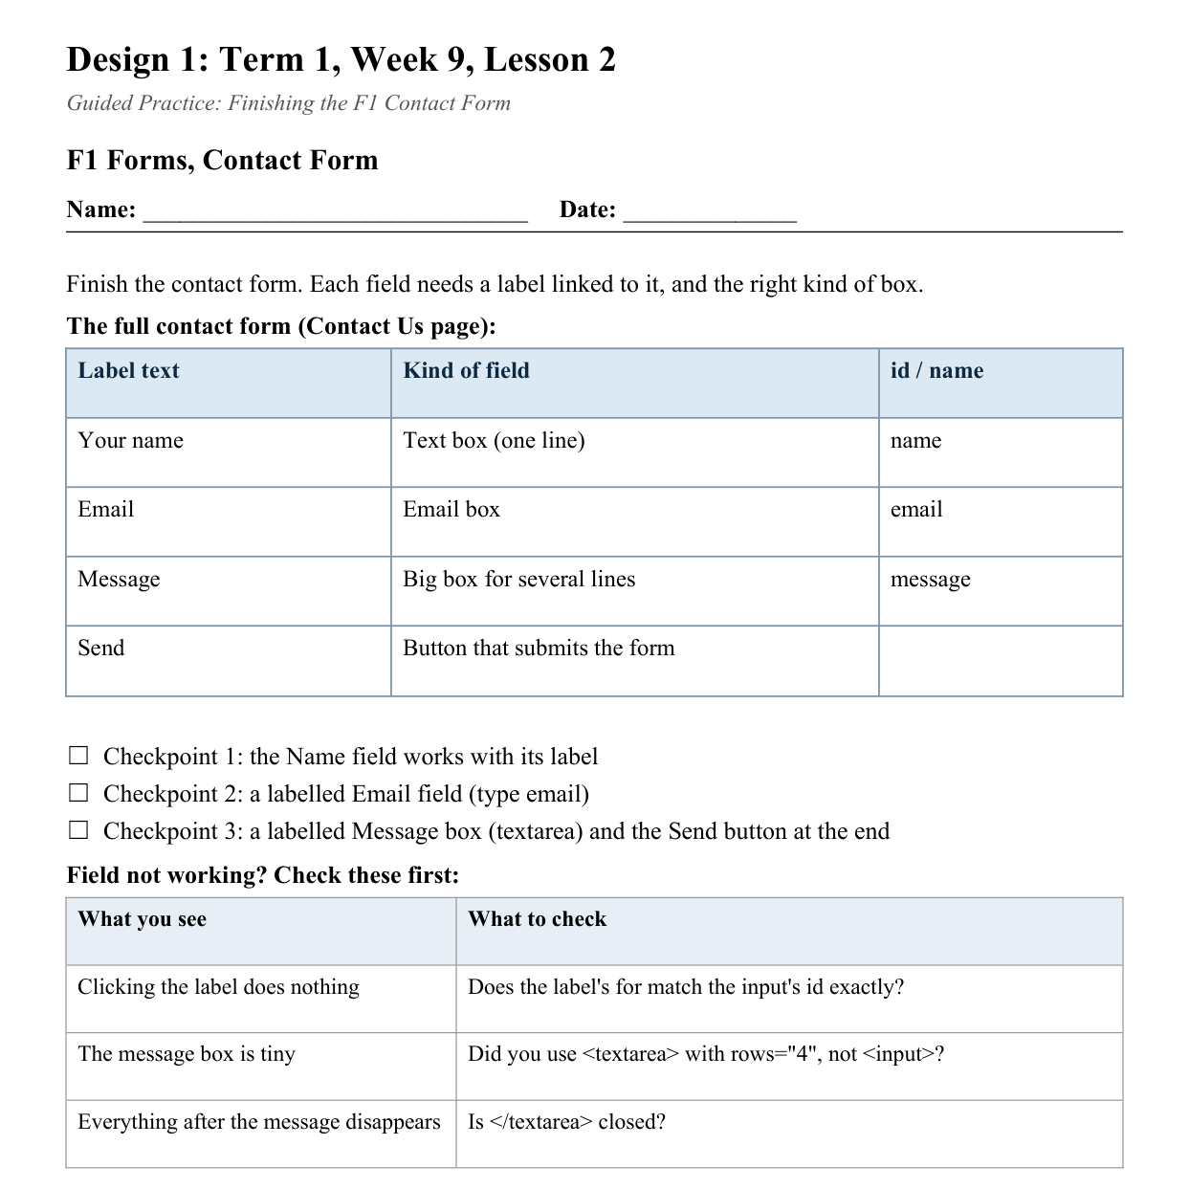
LESSON CORE
You Do: Finish and Test
Finish the contact form on Contact Us.
Then a partner clicks every label to test it.
Activity: F1 Forms, Contact Form
Gradual Release of Responsibility
30 - 40 minutes
3 / 3

Slide 10
CLOSURE
Partner Demo
Click each label for a partner and show it selects the right field.
Transition & Extend
5 - 10 minutes

